Slide 1
Methods of Data Collection and Production
Team Project Presentation
Gender Differences in Fear of Crime
Anthony Papageorgiou
Sunmin Hong
Jinju Suk
Md Eyasin Ul Islam Pavel

Slide 2
Introduction
Background
Fear of crime significantly impacts individuals' quality of life and shapes public policy, with notable gender differences reported globally
Research Gap
Limited research directly comparing gender differences using multiple levels of variables (individual, neighborhood, and city characteristics)
Study Overview
Analysis of South Korean sample (N=1,000) examining how various factors influence fear of crime differently between men and women

Slide 3
Literature Review
Theories
Differential Socialization Theory
Boys socialized to be strong and internalize fear
Girls socialized to express fear and assess vulnerability
Early gender roles influence fear perception
Vulnerability Hypothesis
Physical vulnerability (size, strength)
Social vulnerability (income, education)
Environmental vulnerability (neighborhood)

Slide 4
Literature Review
Previous Studies
Individual Characteristics
Age: Mixed results
Education/Income: Higher → Less fear
Victimization: Direct/Indirect → More fear
Neighborhood Characteristics
Physical disorder ↑ = Fear ↑
Social disorder ↑ = Fear ↑
City Characteristics
Urban areas: Higher fear
Crime rates ↑ = Fear ↑
Population density: Mixed results

Slide 5
Methods
Data Collection and Measure
Data Collection
Survey Period: October 21-28, 2021
Sample: 1,000 South Korean adults (age 19-69)
Method: Mobile survey by Hankook Research (Secondary data)
Sampling: Quota sampling (region, gender, age)
Dependent Variable (mean index of 5 items)
Fear of Crime: Home break-ins, Assault, Harassment, Vandalism, Theft (α = .837)
Independent Variables
Individual Characteristics
Age, education, income, household type, victimization
Neighborhood Characteristics
Physical disorder (α = .801), Social disorder (α = .798)
City Characteristics
Metropolitan status, Crime rate (2018-2020)

Slide 6
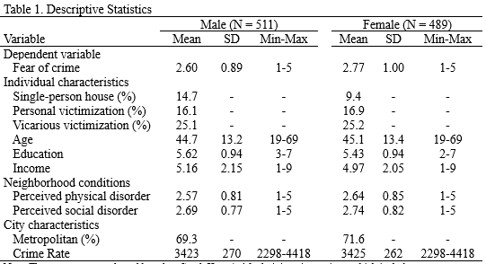
Methods
Methods
Analysis Strategy
OLS Regression
Separate models for male (N=511) and female (N=489) subsamples
Three levels of independent variables included simultaneously
Coefficient Comparison
Comparing effects between male and female models (Z score test)
Testing significance of gender differences in predictor effects
Model Validation
Multicollinearity check: Mean VIF is 1.29
No Heteroskedasticity

Slide 7
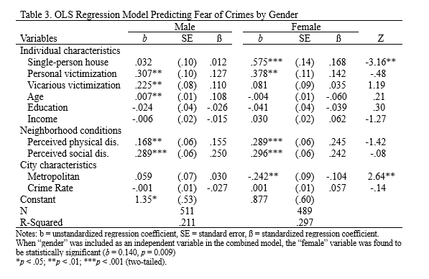
Results
Common Effects
Both physical and social disorder significantly increased fear of crime for all
Gender Differences
Single-person households increased fear of crimes only for women
Metropolitan living decreased fear for women, no effect for men

Slide 8
Discussion
Analysis Strategy
Implications
Need for gender-specific crime prevention strategies
Special attention required for women living alone
Urban infrastructure and safety measures in large cities appear effective for women
Limitations
Sample limited to South Korean population - may not generalize globally
Cross-sectional data - cannot establish causal relationships

Slide 9
Conclusion
Living alone and city size create significant gender differences in fear of crime: women experience much higher fear when living alone, while living in large cities reduces their fear compared to men
These findings can help policymakers develop better strategies for urban safety planning and residential environments focused on crime prevention

Slide 10
Thank you
Insert the title of your subtitle Here

